Slide 1




Welcome to the 2024 Hall of Fame

Slide 2
Erik Visser Athletic Director
Welcome
Hall of Fame members in attendance
Naming Projects
Athletic Director Team Award
Athlete of the Year

Slide 3

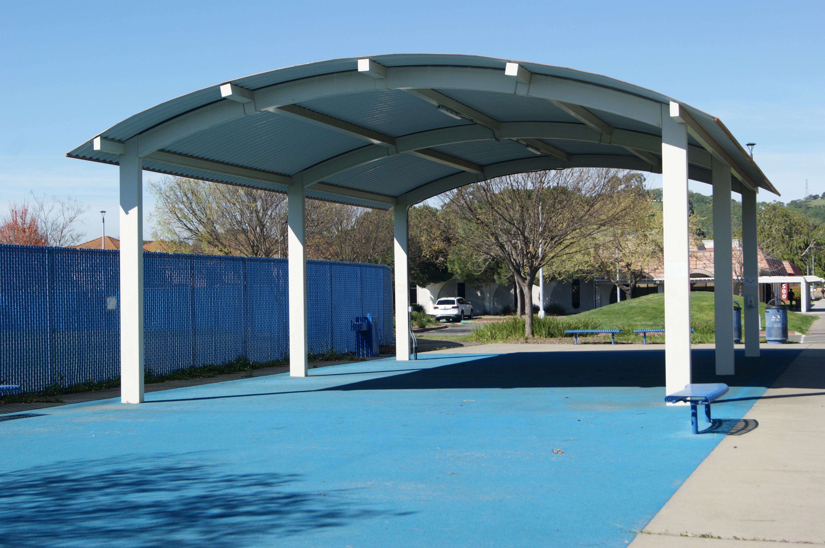
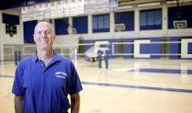
The Robert Myers Pavilion
1992-2011 Dean and Athletic Director
Hall of Fame Member 2011 Class

Slide 4
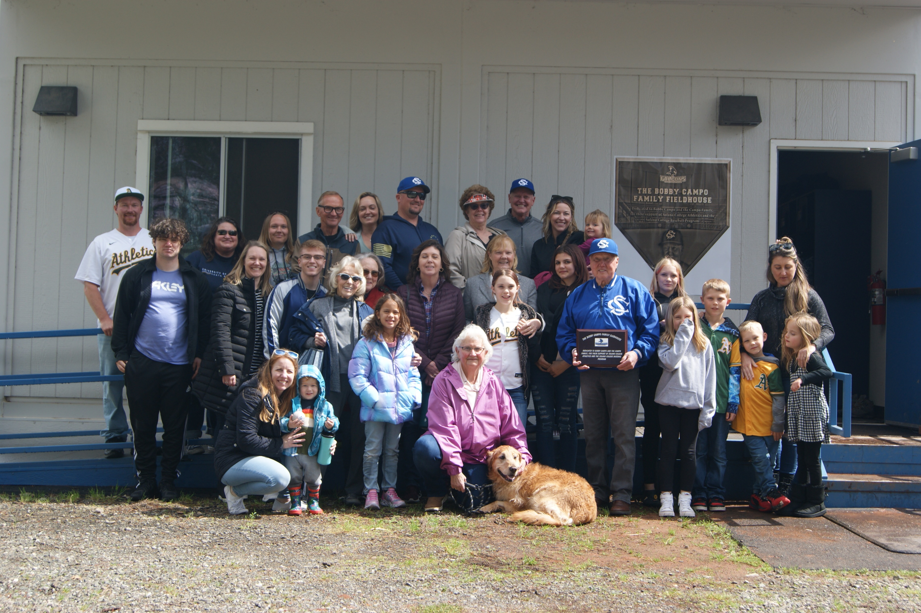

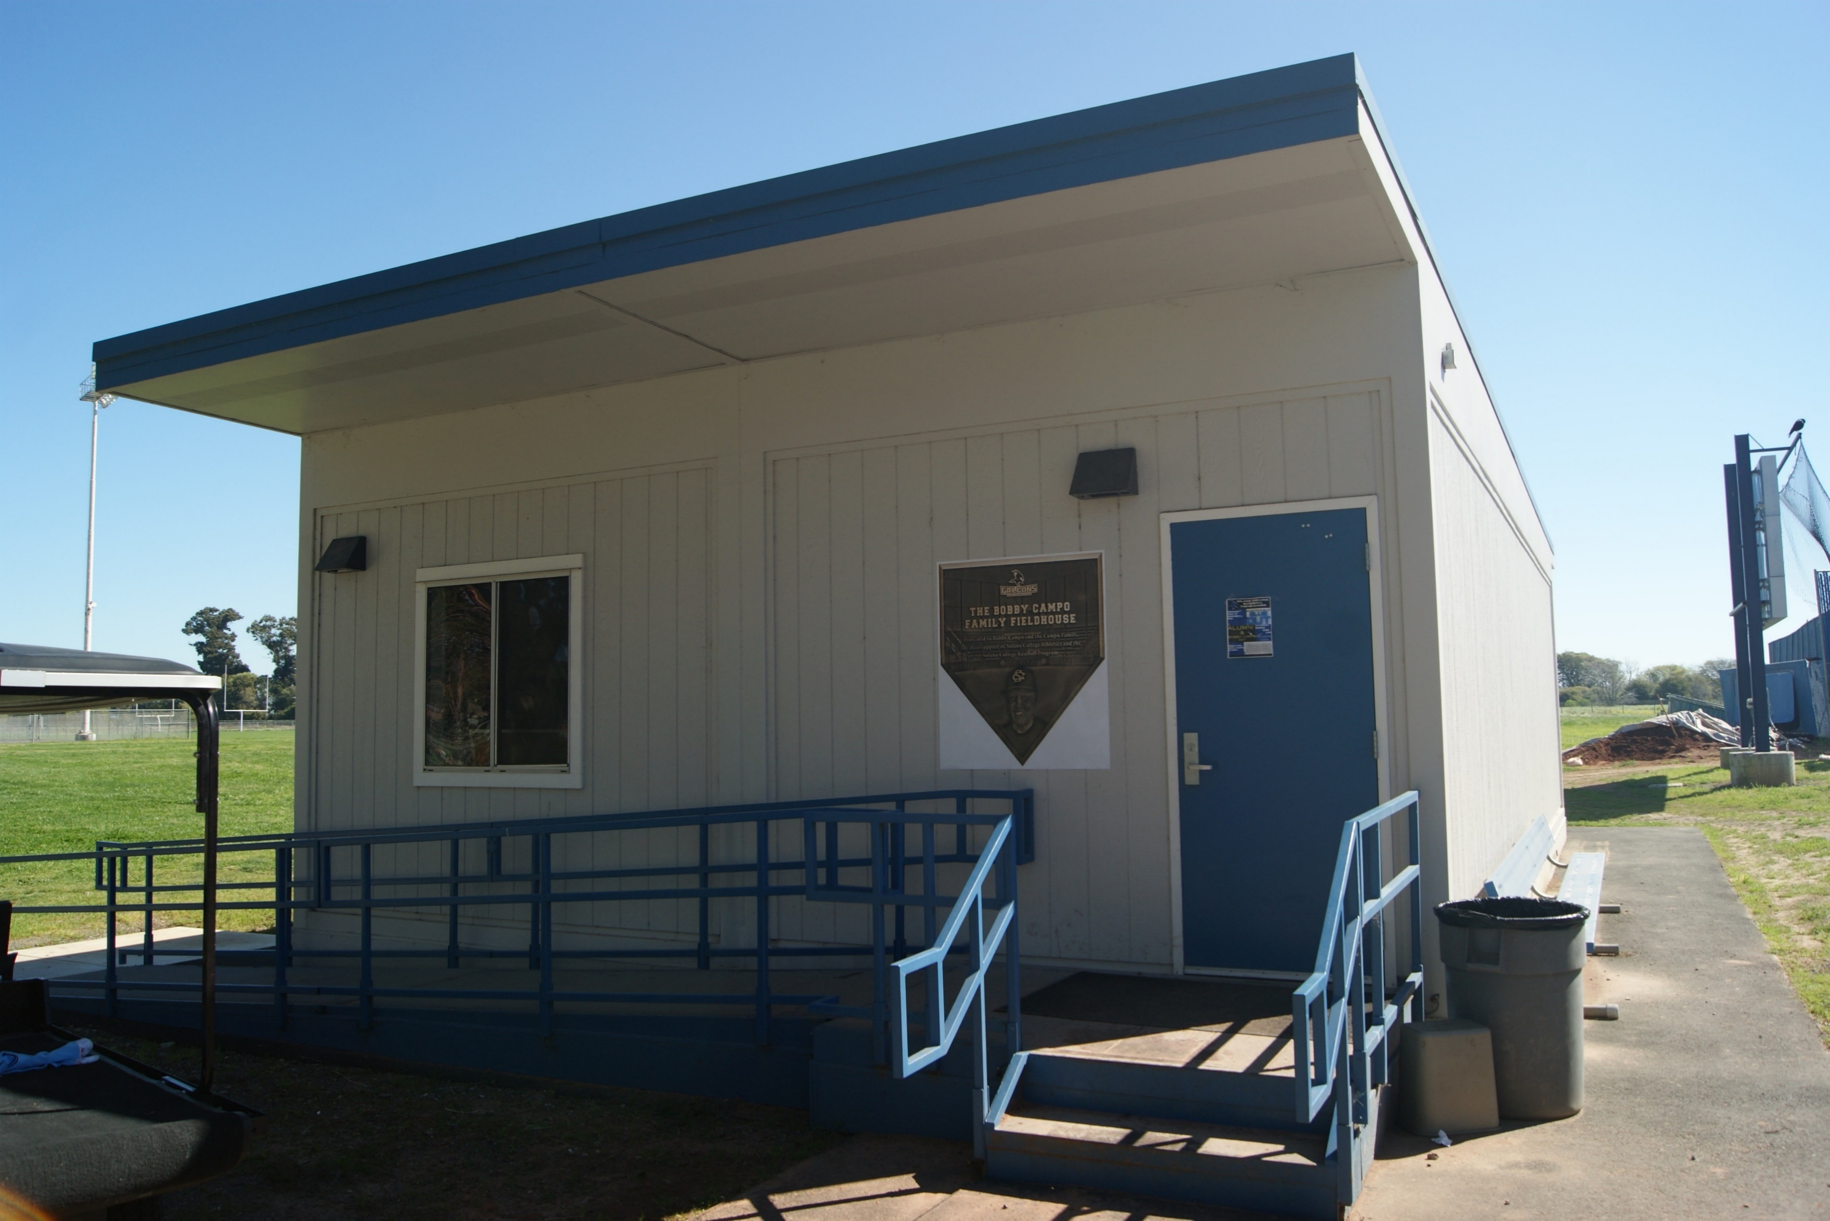

The Bobby Campo Family Fieldhouse
Hall of Fame 2004 Class

Slide 5
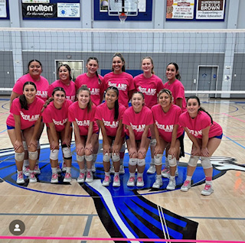

AD Award
Team of the Year of 2023-2024
VOLLEYBALL

Slide 6
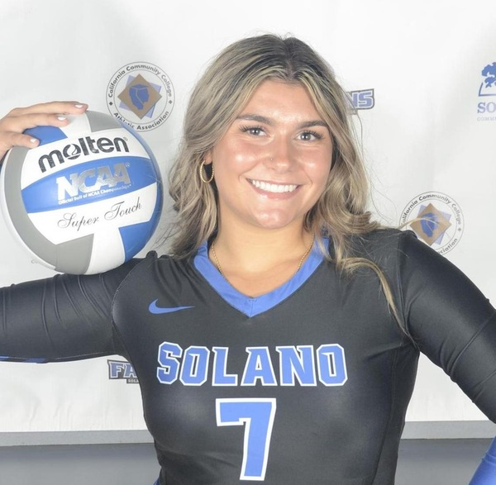
Athlete of the Year of 2023-2024
VOLLEYBALL-Libero
LEXI VASQUEZ
Vacaville High School

Slide 7

Hall of Fame 2024
WELCOME INDUCTEES

Slide 8
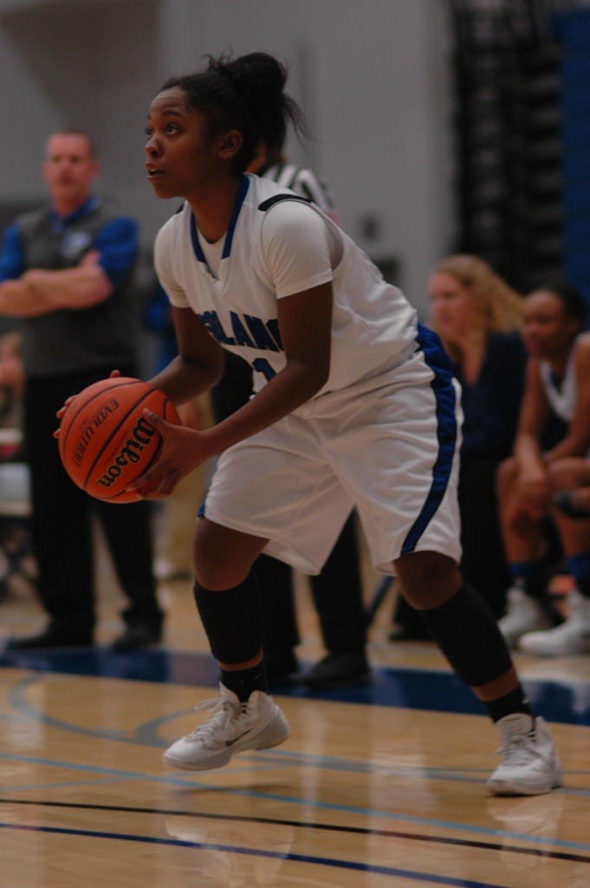

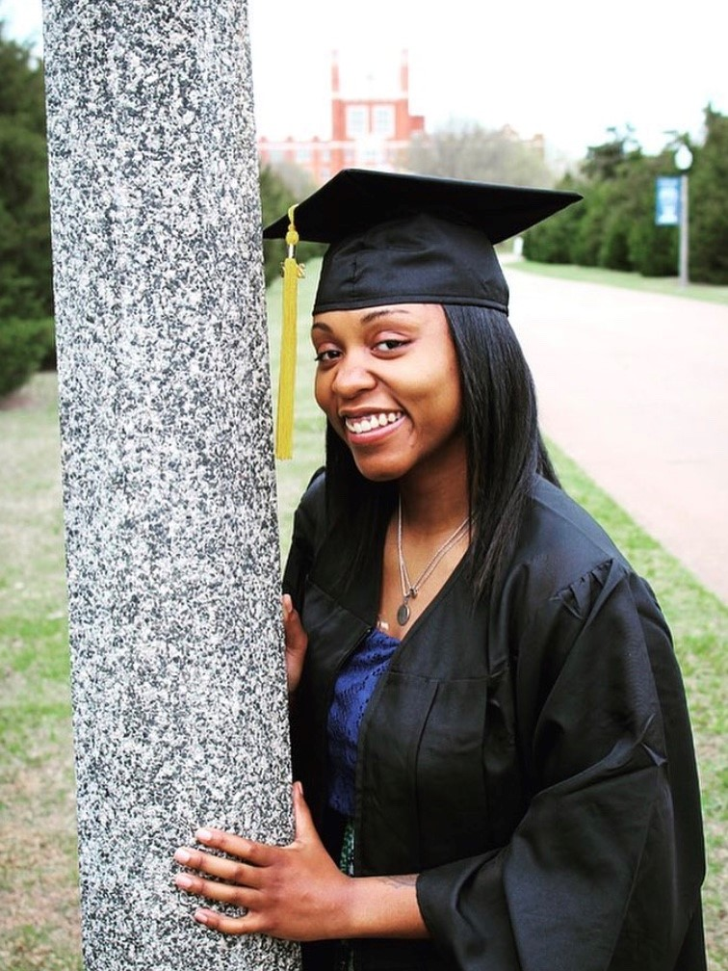
Denisha Lundy
WOMENS BASKETBALL 2013

Slide 9
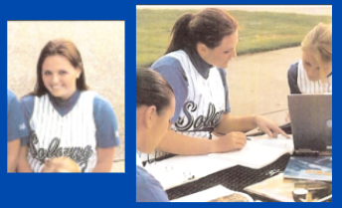

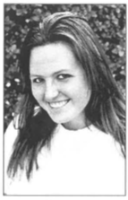

SOFTBALL 2006
Jessica Kerr

Slide 10
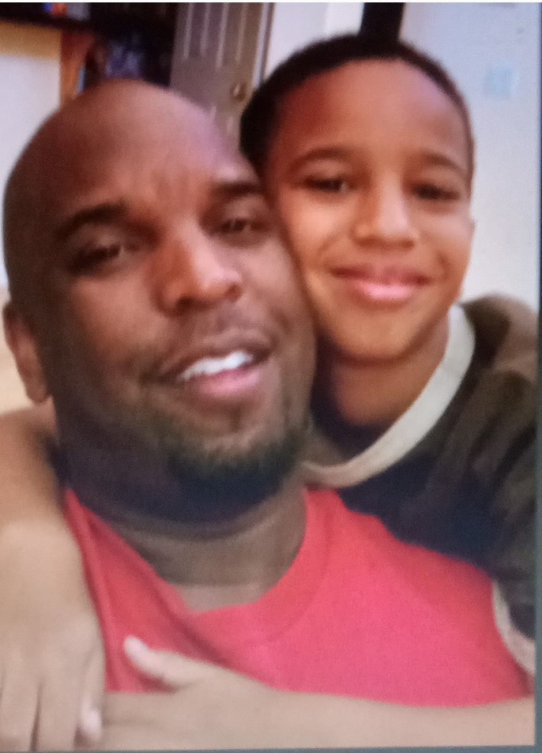
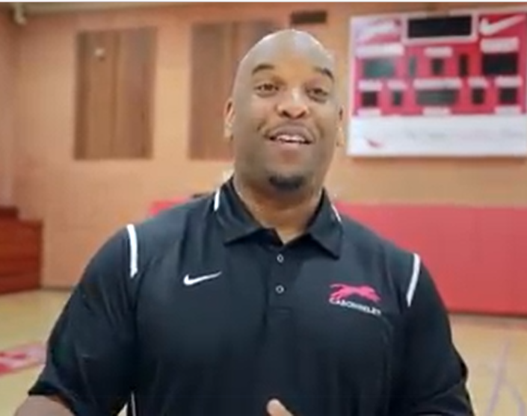
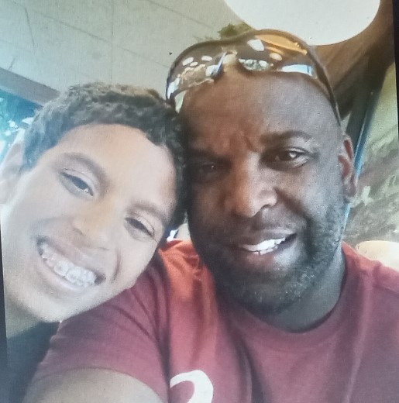
Men’s Basketball 1990
Mike Morris

Slide 11
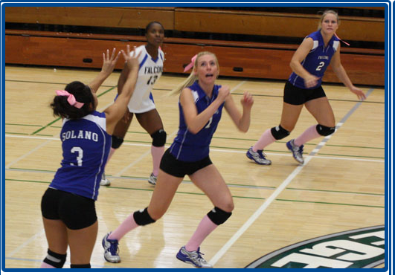

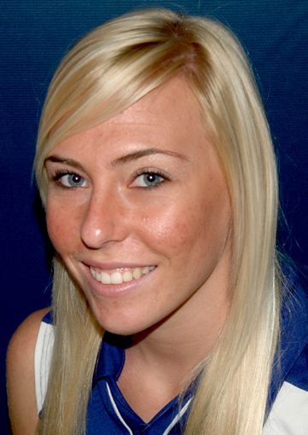
Volleyball 2009 & 2010
Samantha Dean

Slide 12
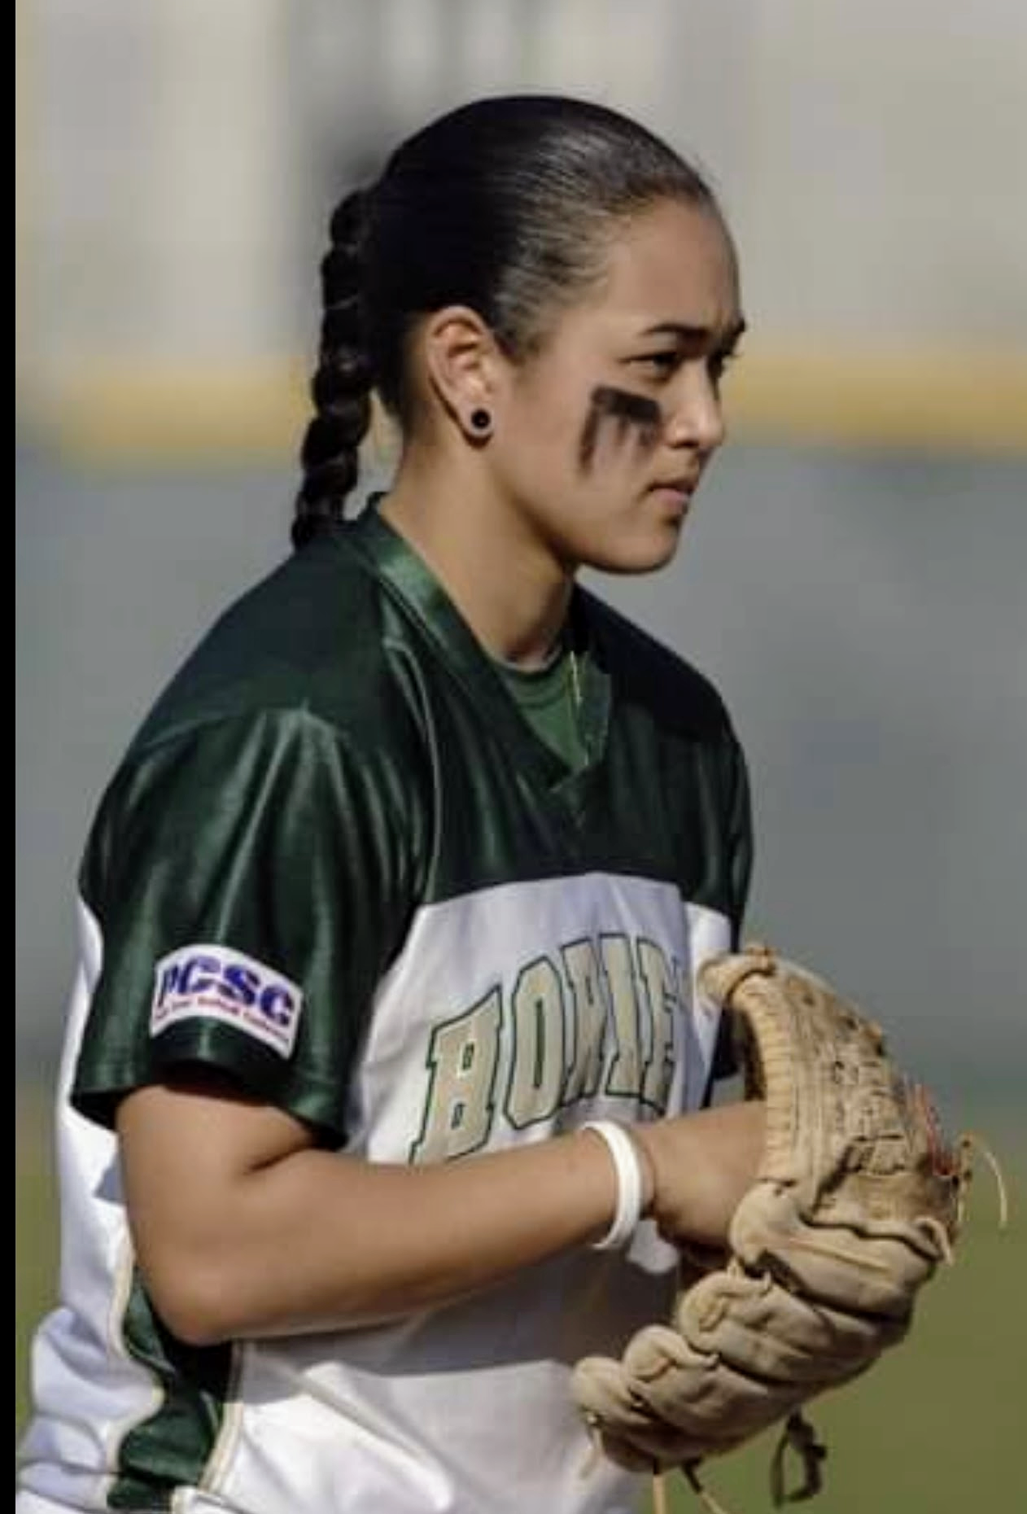
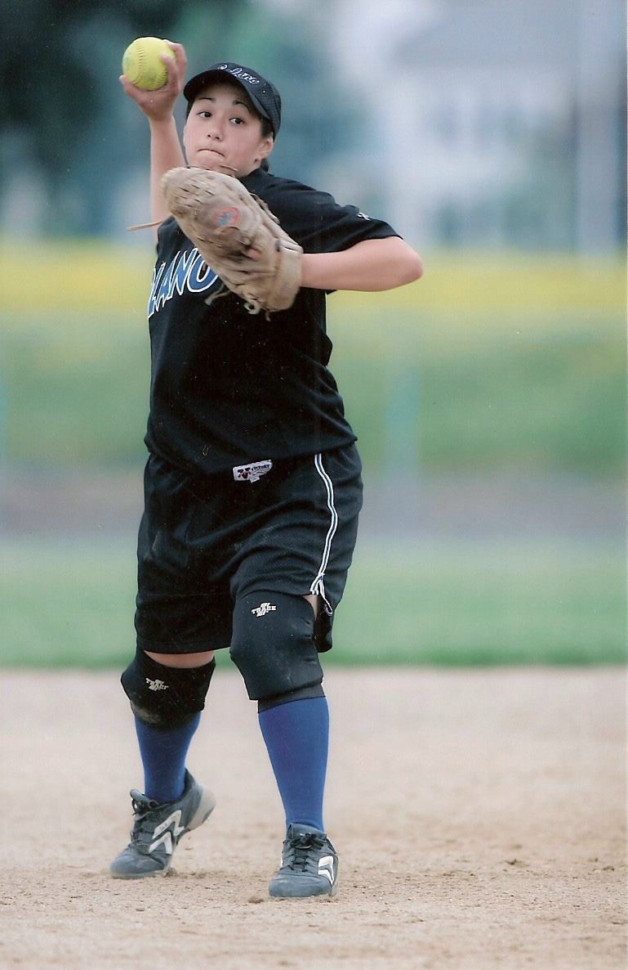

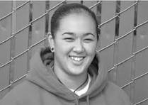
Softball 2005 & 2006
Sherry Clark

Slide 13
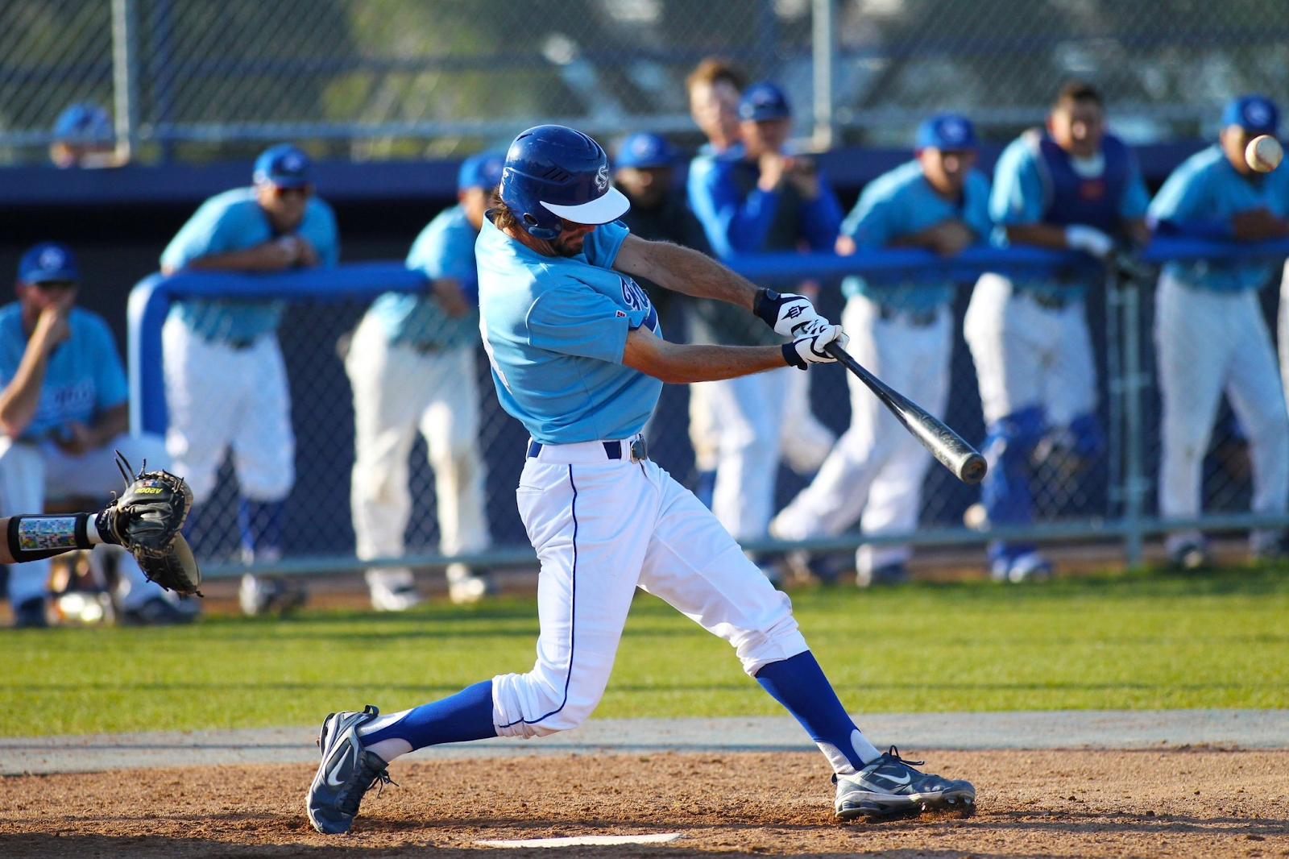
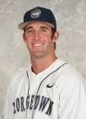

Baseball 2010 & 2011
Trevor Matern

Slide 14
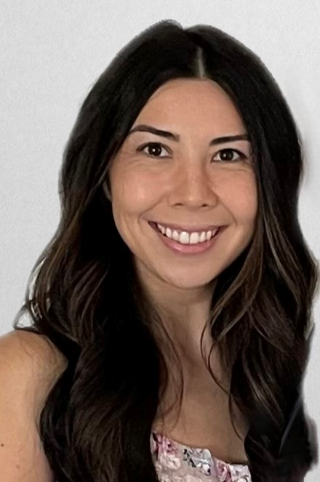
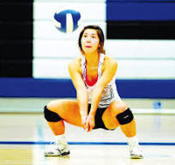
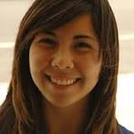
Volleyball 2009 & 2010
Allyson Taynton

Slide 15
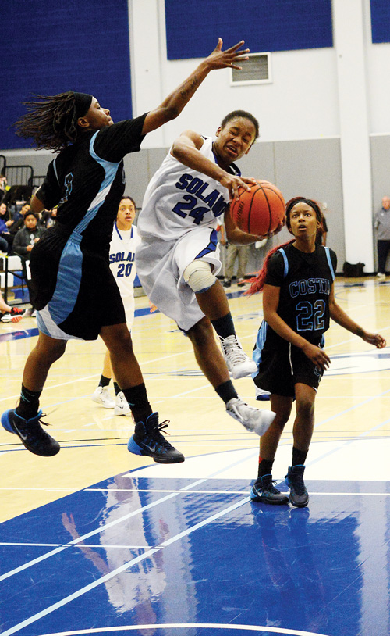
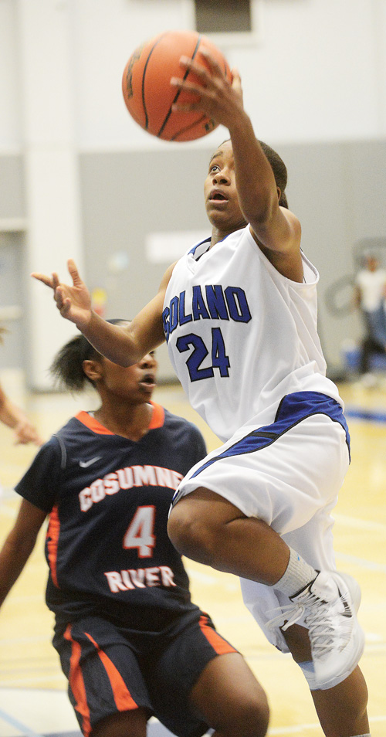
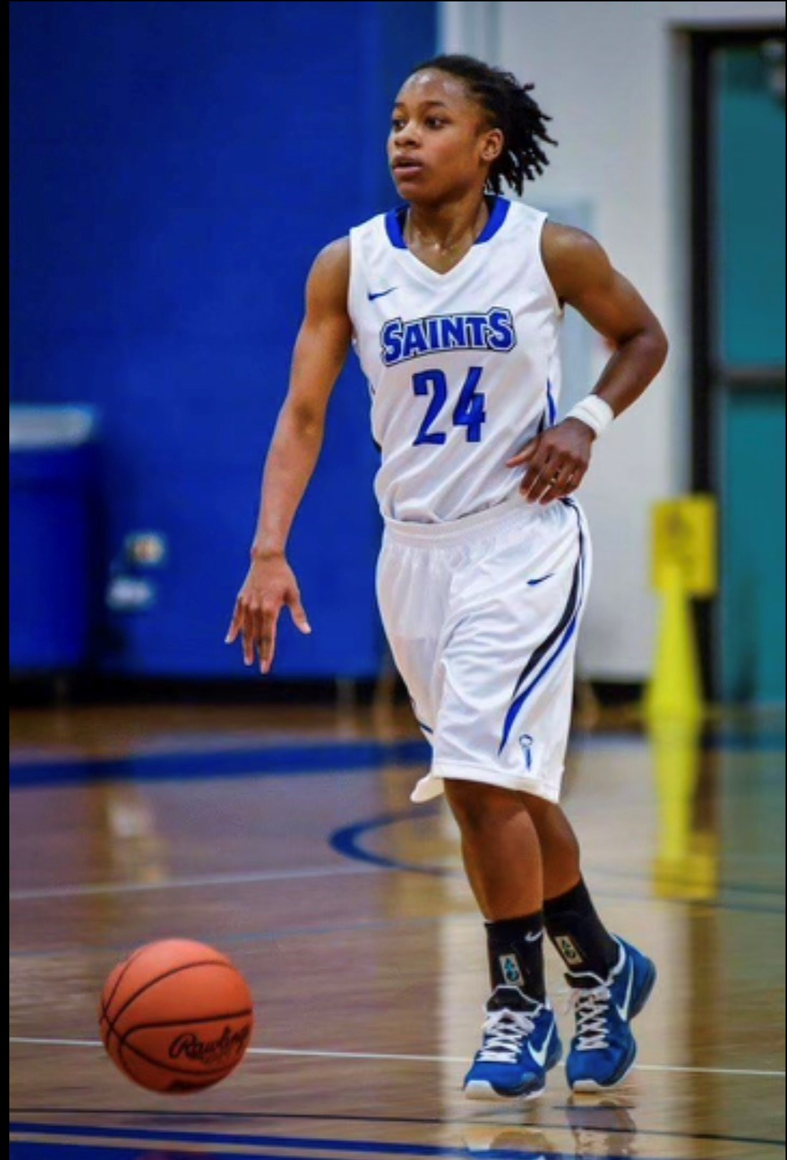
Taylor Hamilton
Women’s Basketball 2012 & 2013

Slide 16
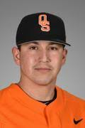
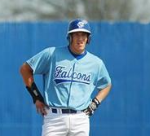
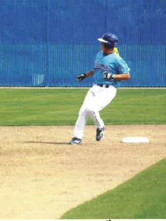
Baseball 2010 & 2011
Victor Romero
VIDEO LINK

Slide 17
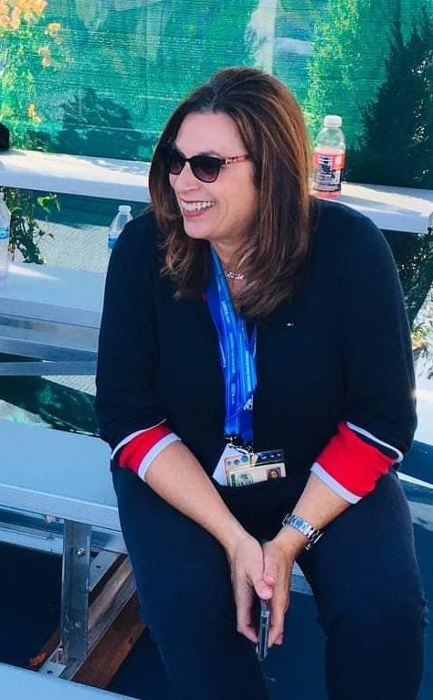
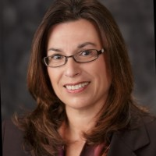


Superintendent-President
Solano Community College
2016-present
Celia Esposito-Noy

Slide 18
Special recognition
2011 Baseball Team

Slide 19
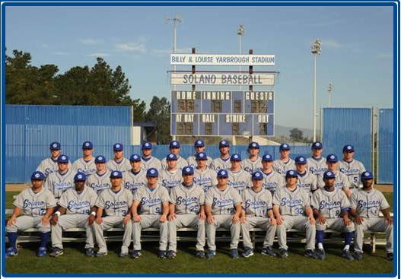
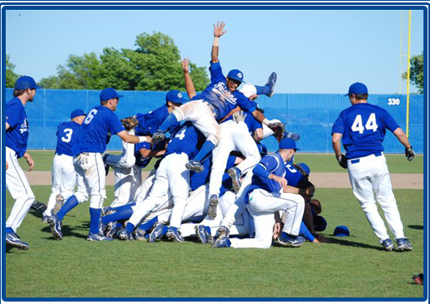

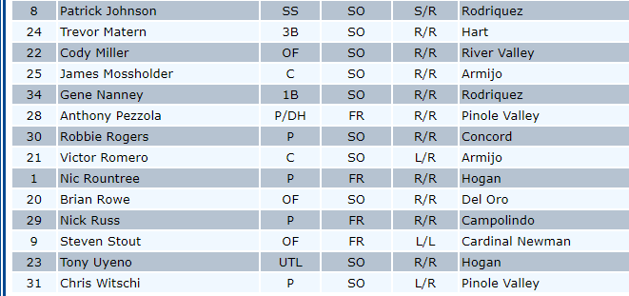
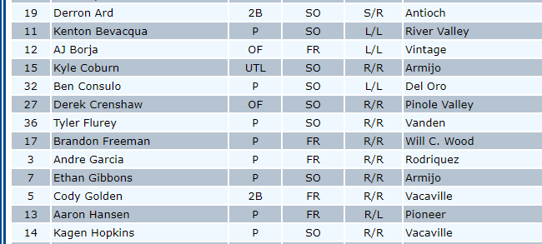

Slide 20
Honors and Awards
Aaron Hansen, 2011 1st Team All-Conference, Pitcher
Victor Romero, 2011 1st Team All-Conference, Catcher
Gene Nanney, 2011 1st Team All-Conference, 1st Base, "Defensive Player of the Year"
Trevor Matern, 2011 1st Team All-Conference, Infielder
Derron Ard, 2011 1st Team All-Conference, Infielder
Kagen Hopkins, 2011 2nd Team All-Conference, Pitcher
Patrick Johnson, 2011 2nd Team All-Conference, Infielder
James Mossholder, 2011 2nd Team All-Conference, Designated Hitter
Scott Stover, 2011 BVC Coach of the Year
National and Regional Awards
Ethan Gibbons, 2011 ABCA/Rawlings Pacific Association All-American 3rd Team & CCCBCA
All-American
Victor Romero, 2011 CCCBCA All-American
Derron Ard, 2011 CCCBCA All-Nor Cal

Slide 21
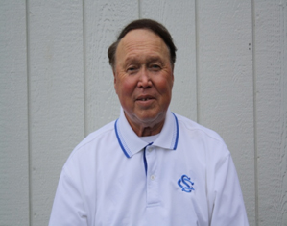
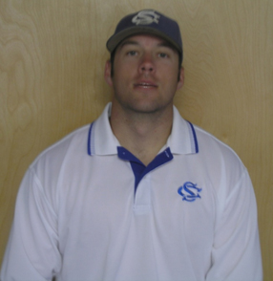
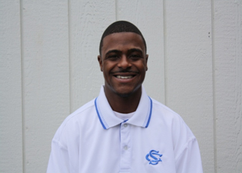
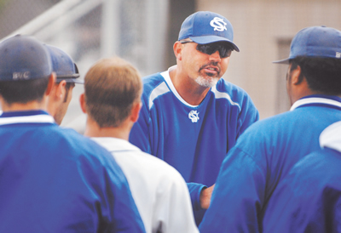
BOBBY CAMPO KODY KEROHER BINO THOMPSON
Scott Stover
HEAD COACH
2002-PRESENT

Slide 22
Thank you for attending….
CONGRATULATIONS TO THE 2024
SOLANO ATHLETICS HALL OF FAME CLASS

